Slide 1
RATHINAM
CENTRE OF EXCELLENCE
Database Management System
Structured Query Language - SQL
by
Mrs.B. Sharmila
Technical Trainer

Slide 2
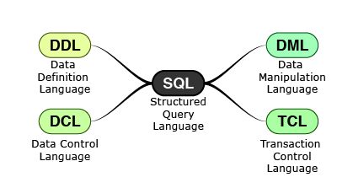
Introduction to SQL
SQL is a language designed specifically for communicating with databases.
Following are the SQL Manipulation Commands.
Structured Query language - SQL

Slide 3
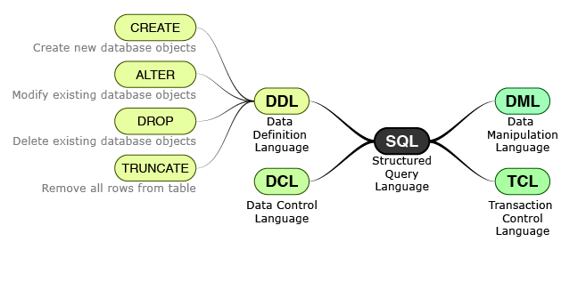
DDL - SQL Commands
Data Definition Language consists of commands which are used to define the structure of database ( i.e. schema of a relational database).
The output of DDL is placed in data dictionary which contains metadata (i.e. data about data).
Structured Query language - SQL

Slide 4
DDL – CREATE Command
It is used to create a new database objects in the database.
Creating a Database:
CREATE DATABASE DATABASENAME;
Using a Database:
USE DATABASENAME;
Displaying the Databases:
SHOW Databases;
Deleting a Database:
DROP DATABASE DATABASENAME;
Structured Query language - SQL

Slide 5
Demo – Creation Of Database
Structured Query language - SQL

Slide 6
DDL – CREATE Command
Creating a Table:
CREATE TABLE TABLE_NAME (COLUMN_NAME DATATYPES[,....]);
Creating a Student Table:
CREATE TABLE STUDENT
(
ROLL_NO INT,
NAME VARCHAR (20) ,
ADDRESS CHAR (25),
PHONE INT ,
AGE INT ,
DEPTNAME VARCHAR(20)
);
ROLL_NO | NAME | ADDRESS | PHONE | AGE | DEPTNAME
Structured Query language - SQL

Slide 7
Demo – Creation Of Table

Slide 8
DDL – ALTER Command
It is used to modify the structure of the database objects.
to modify the characteristics of an existing attribute
to add a new attribute.
To add a new column in the table:
ALTER TABLE table_name ADD column_name COLUMN-definition;
To modify existing column in the table:
ALTER TABLE table_name MODIFY(column_definitions....);
Structured Query language - SQL

Slide 9
DDL – ALTER Command
Altering a Student Table:
To add a new column in the table:
ALTER TABLE Student ADD Marks VARCHAR(10);
To modify existing column in the table:
ALTER TABLE Student MODIFY Marks INT;
ROLL_NO | NAME | ADDRESS | PHONE | AGE | DEPTNAME | MARKS
Structured Query language - SQL

Slide 10
Demo for ALTER Command
Structured Query language - SQL

Slide 11
DDL – Drop Command
It is used to delete both the structure and record stored in the table.
To drop a table:
DROP TABLE Student;
Drop frees the space occupied by the table.
Applying drop on the unnecessary table will improve the performance of DB.
To drop Column in a table:
ALTER TABLE Student DROP COLUMN Marks;
ROLL_NO | NAME | ADDRESS | PHONE | AGE | DEPTNAME | MARKS
ROLL_NO | NAME | ADDRESS | PHONE | AGE | DEPTNAME
Structured Query language - SQL

Slide 12
Demo for DROP Command
Structured Query language - SQL

Slide 13
DDL – Truncate Command
It is used to delete all the rows from the table.
To Truncate a table:
TRUNCATE TABLE Student;
Structured Query language - SQL

Slide 14
Demo for TRUNCATE Command
Structured Query language - SQL

Slide 15
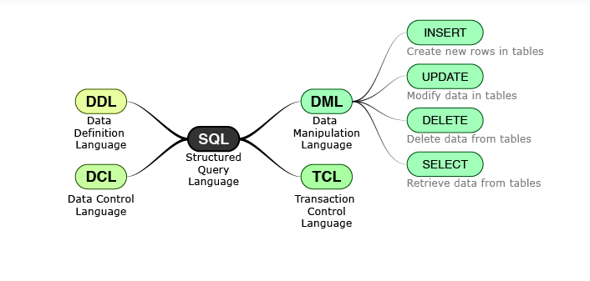
DML - SQL Commands
Data Manipulation Language enables users to access or manipulate data in a relational database.
DML provides commands for Insertion, retrieval, deletion and modification of information in a database.
Structured Query language - SQL

Slide 16
DML – Insert Command
It is used to insert data into a table.
It is possible to write the INSERT INTO statement in two ways:
INSERT INTO table_name (column1, column2, column3, ...) VALUES (value1, value2, value3, ...);
INSERT INTO table_name VALUES (value1, value2, value3, ...);
ROLL_NO | NAME | ADDRESS | PHONE | AGE
1 | RAM | DELHI | 9455123451 | 18
2 | RAMESH | GURGAON | 9652431543 | 18
3 | SUJIT | CHENNAI | 9156253131 | 20
4 | SURESH | HYDERABAD | 9442951245 | 18
Structured Query language - SQL

Slide 17
Demo for INSERT Command
Structured Query language - SQL

Slide 18
DML – UPDATE Command
It is used to update the existing data from the table.
Updating a Database:
UPDATE table_name SET column1 = value1, column2 = value2, ... WHERE condition;
UPDATE Student SET PHONE =123 WHERE PHONE =9455123451;
ROLL_NO | NAME | ADDRESS | PHONE | AGE
1 | RAM | DELHI | 123 | 18
2 | RAMESH | GURGAON | 9652431543 | 18
3 | SUJIT | CHENNAI | 9156253131 | 20
4 | SURESH | HYDERABAD | 9442951245 | 18
ROLL_NO | NAME | ADDRESS | PHONE | AGE
1 | RAM | DELHI | 9455123451 | 18
2 | RAMESH | GURGAON | 9652431543 | 18
3 | SUJIT | CHENNAI | 9156253131 | 20
4 | SURESH | HYDERABAD | 9442951245 | 18
Structured Query language - SQL

Slide 19
Demo for UPDATE Command
Structured Query language - SQL

Slide 20
DML – DELETE Command
It is used to delete the existing rows from the table.
Updating a Database:
DELETE FROM Student WHERE condition;
DELETE FROM Student WHERE ROLL_NO = 2
ROLL_NO | NAME | ADDRESS | PHONE | AGE
1 | RAM | DELHI | 9455123451 | 18
2 | RAMESH | GURGAON | 9652431543 | 18
3 | SUJIT | CHENNAI | 9156253131 | 20
4 | SURESH | HYDERABAD | 9442951245 | 18
ROLL_NO | NAME | ADDRESS | PHONE | AGE
1 | RAM | DELHI | 9455123451 | 18
3 | SUJIT | CHENNAI | 9156253131 | 20
4 | SURESH | HYDERABAD | 9442951245 | 18
ROLL_NO | NAME | ADDRESS | PHONE | AGE
1 | RAM | DELHI | 9455123451 | 18
2 | RAMESH | GURGAON | 9652431543 | 18
3 | SUJIT | CHENNAI | 9156253131 | 20
4 | SURESH | HYDERABAD | 9442951245 | 18
Structured Query language - SQL

Slide 21
Demo for DELETE Command
Structured Query language - SQL

Slide 22
DML – SELECT Command
It is used to fetch the data from the database..
Selecting a Database:
SELECT * FROM TABLE;
ROLL_NO | NAME | ADDRESS | PHONE | AGE
1 | RAM | DELHI | 9455123451 | 18
3 | SUJIT | CHENNAI | 9156253131 | 20
4 | SURESH | HYDERABAD | 9442951245 | 18
Structured Query language - SQL

Slide 23
Demo for SELECT Command
Structured Query language - SQL

Slide 24
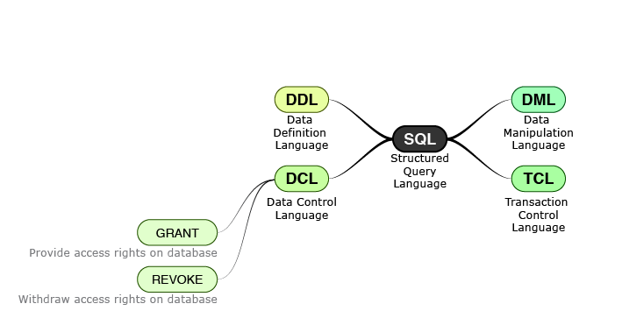
DCL – SQL Command
Data Control Languages includes commands such as GRANT and REVOKE which mainly deal with the rights, permissions, and other controls of the database system.
Structured Query language - SQL
Notes:
Whenever a user submits a query, the database checks against the granted privileges and rejects the query if it is not authorized.

Slide 25
DCL – Grant Command
GRANT : Used to provide any user access privileges or other privileges for the database.
REVOKE : Used to take back permissions from any user.
Structured Query language - SQL

Slide 26


TCL – SQL Command
10000
50000
30000
10000
10000
40000
40000
Structured Query language - SQL

Slide 27
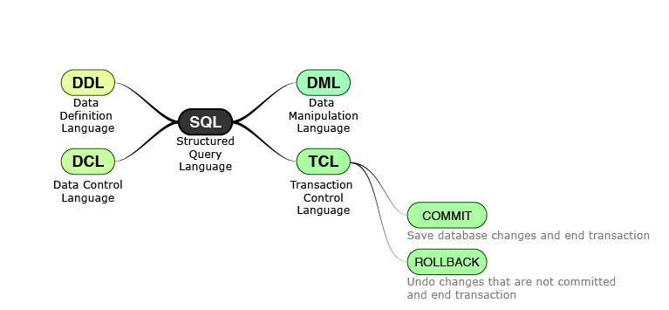
TCL – SQL Command
Transactions group a set of tasks into a single execution unit
Structured Query language - SQL

Slide 28




TCL – COMMIT Command
COMMIT command is used to permanently save any transaction into the database.
When we use any DML command like INSERT, UPDATE or DELETE, the changes made by these commands are not permanent, until the current session is closed, the changes made by these commands can be rolled back.
To avoid that, we use the COMMIT command to mark the changes as permanent.
Account 1
Account 2
Update Account Balance 1
Update Success
BEGIN
COMMIT
Update Account Balance 2
Update Success
Structured Query language - SQL

Slide 29
TCL – ROLLBACK Command
This command restores the database to last committed state.
If we have used the UPDATE command to make some changes into the database, and realize that those changes were not required, then we can use the ROLLBACK command to rollback those changes, if they were not committed using the COMMIT command.
Account 1
Account 2
Update Account Balance 1
Update Success
BEGIN
ROLL BACK
Update Account Balance 2
Update Failed
Structured Query language - SQL

Slide 30
Demo for TCL Command
Structured Query language - SQL

Slide 31
QUIZ
1. Which of the following are classifications of SQL? [Choose any TWO]
Data Definition Language
Data Manipulation Language
Extensible Markup Language
Security Assertion Markup Language
2. Maria, a database programmer wants to change the marks of a student present in the marks column of the student table.
Which of the following command should she use?
Insert
Delete
Update
Alter
3. Determine the appropriate command classification for the following command.
Command- ALTER ( Modifies existing database objects like tables )
DCL
DDL
DML
TCL
Structured Query language - SQL

Slide 32
QUIZ
4. Determine the appropriate command classification for the following command.
Command- REVOKE ( Remove access to database objects like tables from users )
DCL
DDL
DML
TCL
5. To save the database changes permanently commands from which command classification should be used?
DCL
DDL
DML
TCL
6. Alex, a database programmer has to add the details about a new student into the student table. In order to do that he has used INSERT Command.
Determine the appropriate command classification for INSERT.
DCL
DDL
DML
TCL
Structured Query language - SQL

Slide 33
QUIZ
7. Determine the appropriate command classification for the following command.
Command- TRUNCATE ( Empty a table by deleting all rows )
DCL
DDL
DML
TCL
8. Select the correct statement.
With the DDL commands, any structural changes can be made to the table, including creation, deletion, and alteration.
With the DML commands, any structural changes can be made to the table, including creation, deletion, and alteration.
With the DCL commands, any structural changes can be made to the table, including creation, deletion, and alteration.
With the TCL commands, any structural changes can be made to the table, including creation, deletion, and alteration.
Structured Query language - SQL

Slide 34
QUIZ
9. Following the completion of a transaction, it must be executed to save all the operations performed in the transaction. Here we are talking about which command?
REVOKE
COMMIT
ROLLBACK
SAVE
10. Which command will remove the records from the table, but not affect the structure of the table?
REMOVE
DELETE
DROP
TRUNCATE
11. The records and structure of a table may be removed or deleted from the database using which command?
REMOVE
DELETE
DROP
TRUNCATE
Structured Query language - SQL

